Slide 1
How to Elect Your Benefits

Slide 2
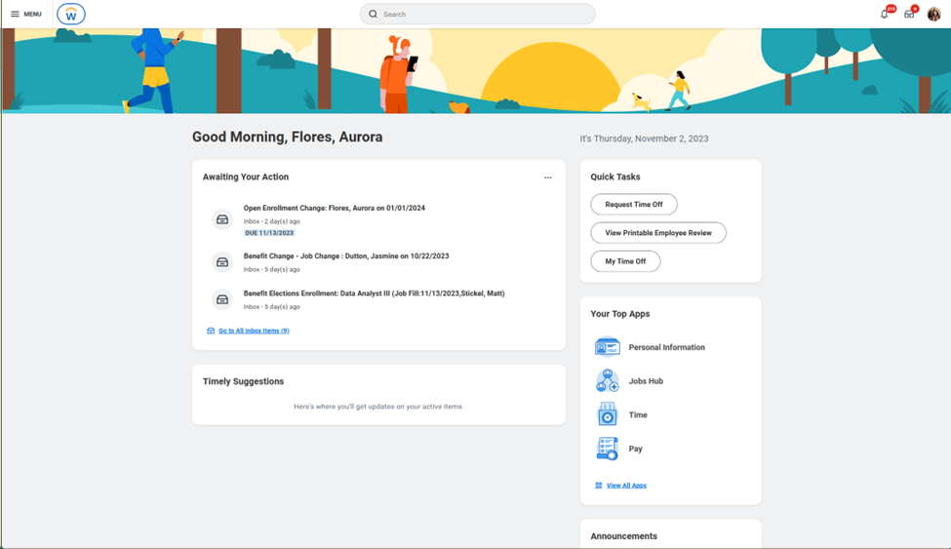
All Benefits Eligible Employees are required to elect their benefits regardless of whether you will be making changes or waiving your benefits
Login to Workday and look for the Open Enrollment Inbox Task

Slide 3
Select Benefits Open Enrollment.
Click Continue
Answer Question
Continue to next screen

Slide 4
Important Information on Benefit Elections
Medical Coverage:
The Navigators is changing health insurance carriers to United Healthcare (UHC) beginning January 1, 2024. We will be partnering with UMR, a UHC third-party administrator, and United Healthcare Global (UHC Global) to administer our plans.
What’s New?
Our three domestic medical plans will move from AETNA to UMR.
Our vision and dental plans will now be offered through UHC.
Our life, voluntary life, short-term disability and long-term disability will be offered through The Standard.
We will be moving from Hello Heart to UHC’s cardiovascular health program.

Slide 5
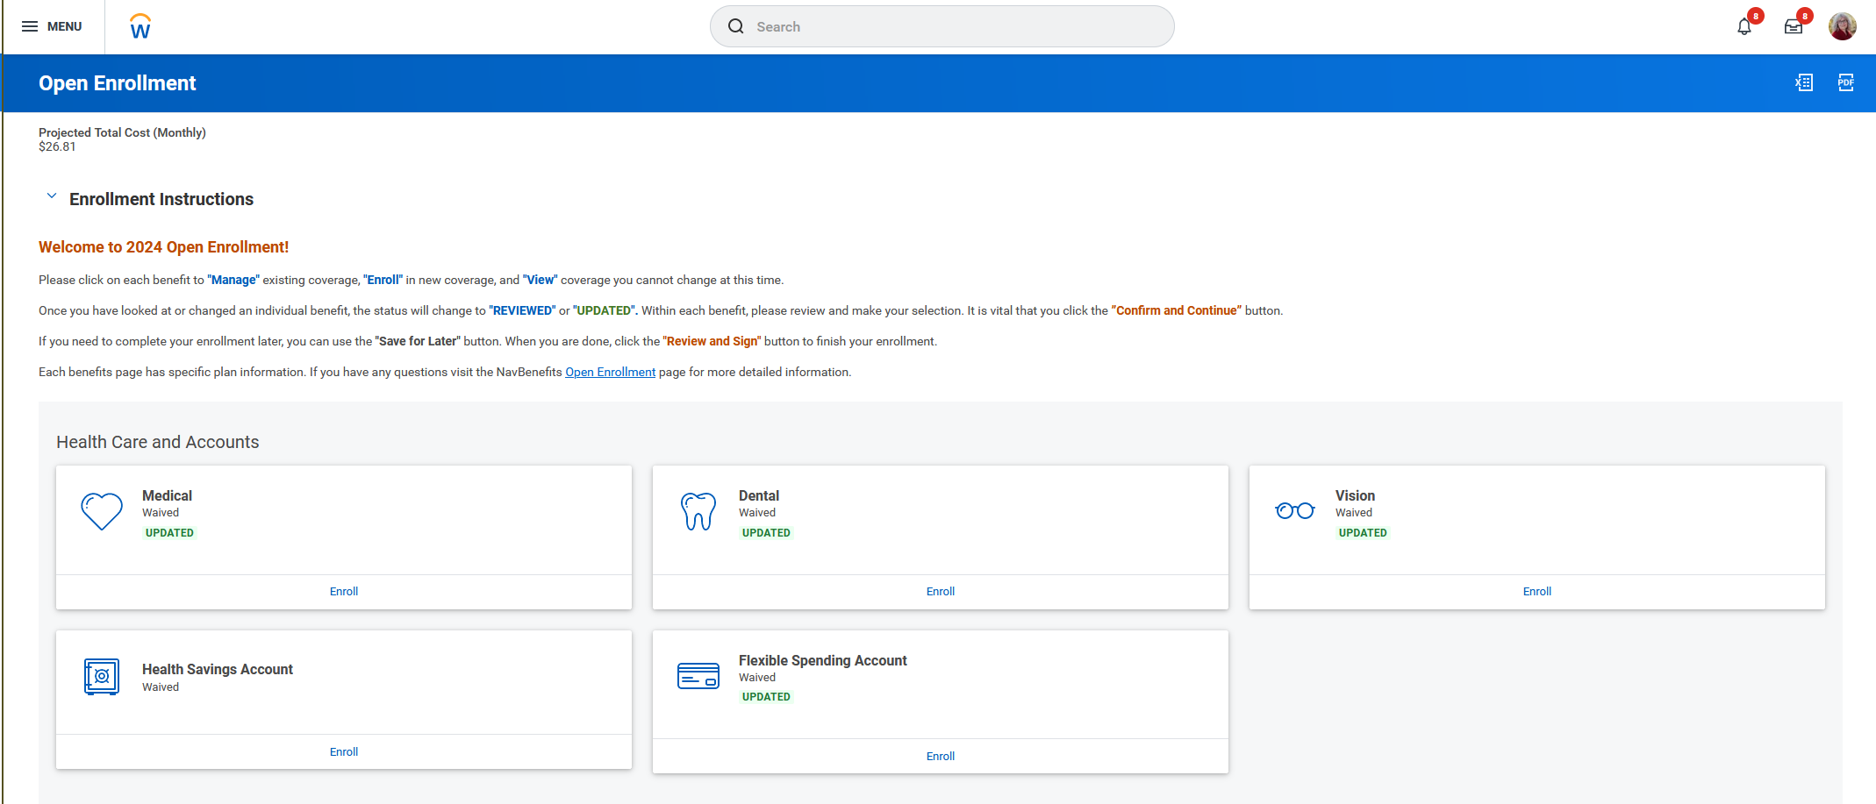
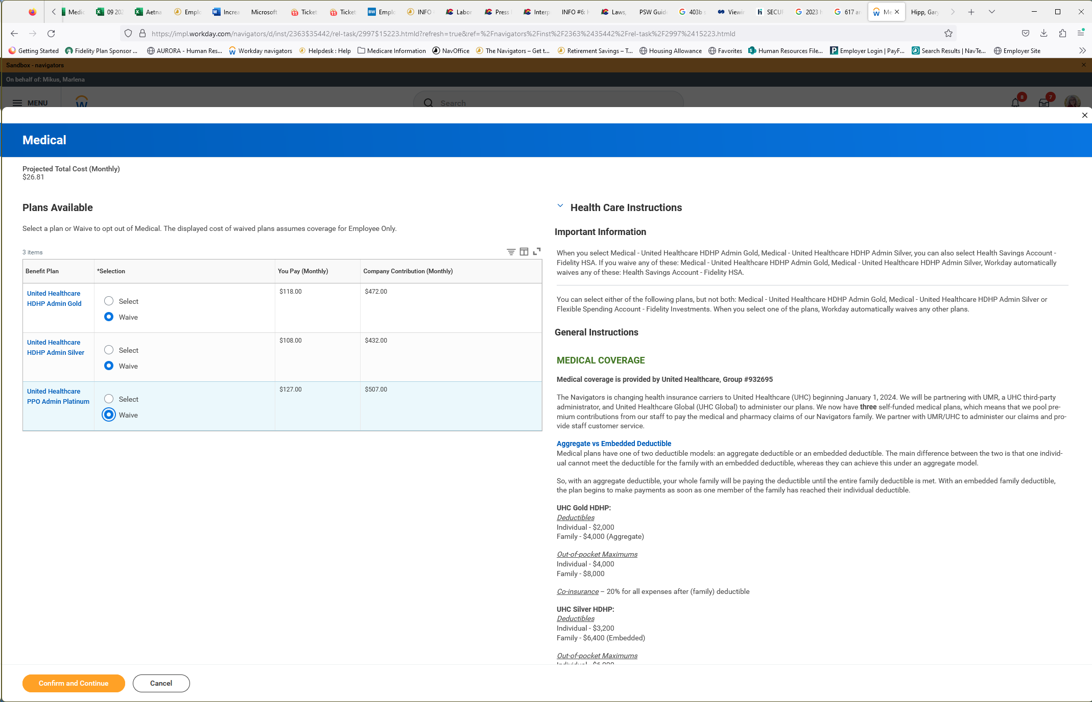
Electing Medical, Dental, and Vision Coverage
To elect a benefit: First select to enroll in the benefit plan, then click Confirm & Continue. Add dependents if needed.
Elections are locked-in after Open Enrollment unless you experience a Life Event. Changes can only be made within 31 days of the Life Event
Field Staff waiving Medical Coverage must meet eligibility and fill out a waiver each year.
Premium rates can be found here. Field Staff rates are considered Employer Contributions.
Elect or waive Dental and Vision coverage.
Continue to HSA/FSA elections

Slide 6
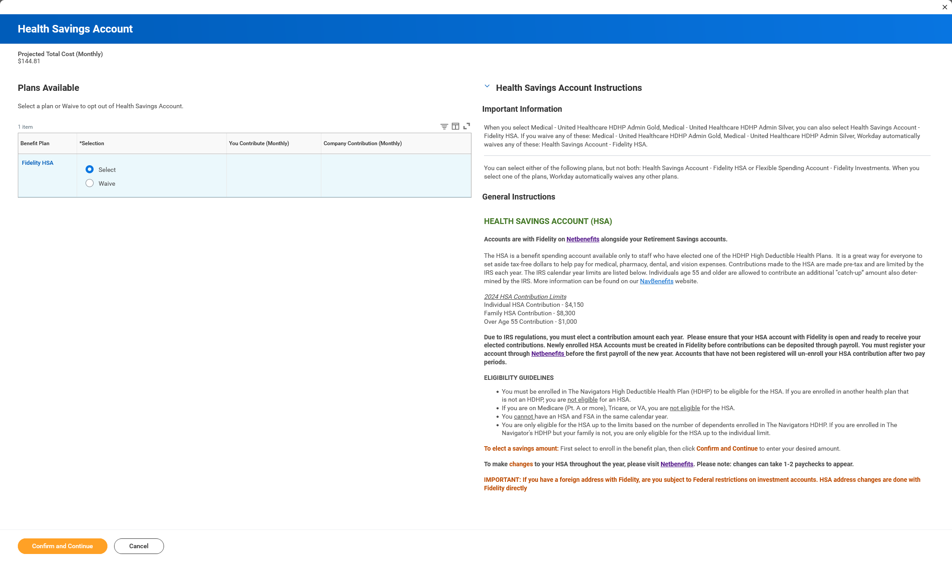
Electing HSA Contributions
HSAs are only available to those who elected the High Deductible Health Plan (HDHP) Medical Plan. Please read the eligibility guidelines on this page carefully.
To elect a savings amount: First select to enroll in the benefit plan, then click Confirm & Continue to enter your desired amount.
Select an annual amount to be divided into 24 deductions or an amount per paycheck (2 deductions a month).
The 2022 IRS maximum contribution amount shown based on your Medical election is $3,650. Reaching this amount is based on 24 deductions.

Slide 7
Fidelity HSA Terms and Conditions
If you have elected to contribute to an HSA, you must agree to Fidelity’s Terms and Conditions. Failure to do so will prevent your HSA account to be able to accept funds.
After reading the Terms & Conditions, check off that you agree and submit to finalize your elections.
Please note:
If you do not agree: You will not be able to participate in the Fidelity HSA and will need to waive the HSA election in Workday.
If you forget: Workday will give you an Error before you are able to submit your elections
If you did not elect the HSA, you will not have the Terms & Conditions
All employees must click Submit to complete your 2024 Benefits Elections. If you do not submit your elections, your Open Enrollment is not complete.

Slide 8
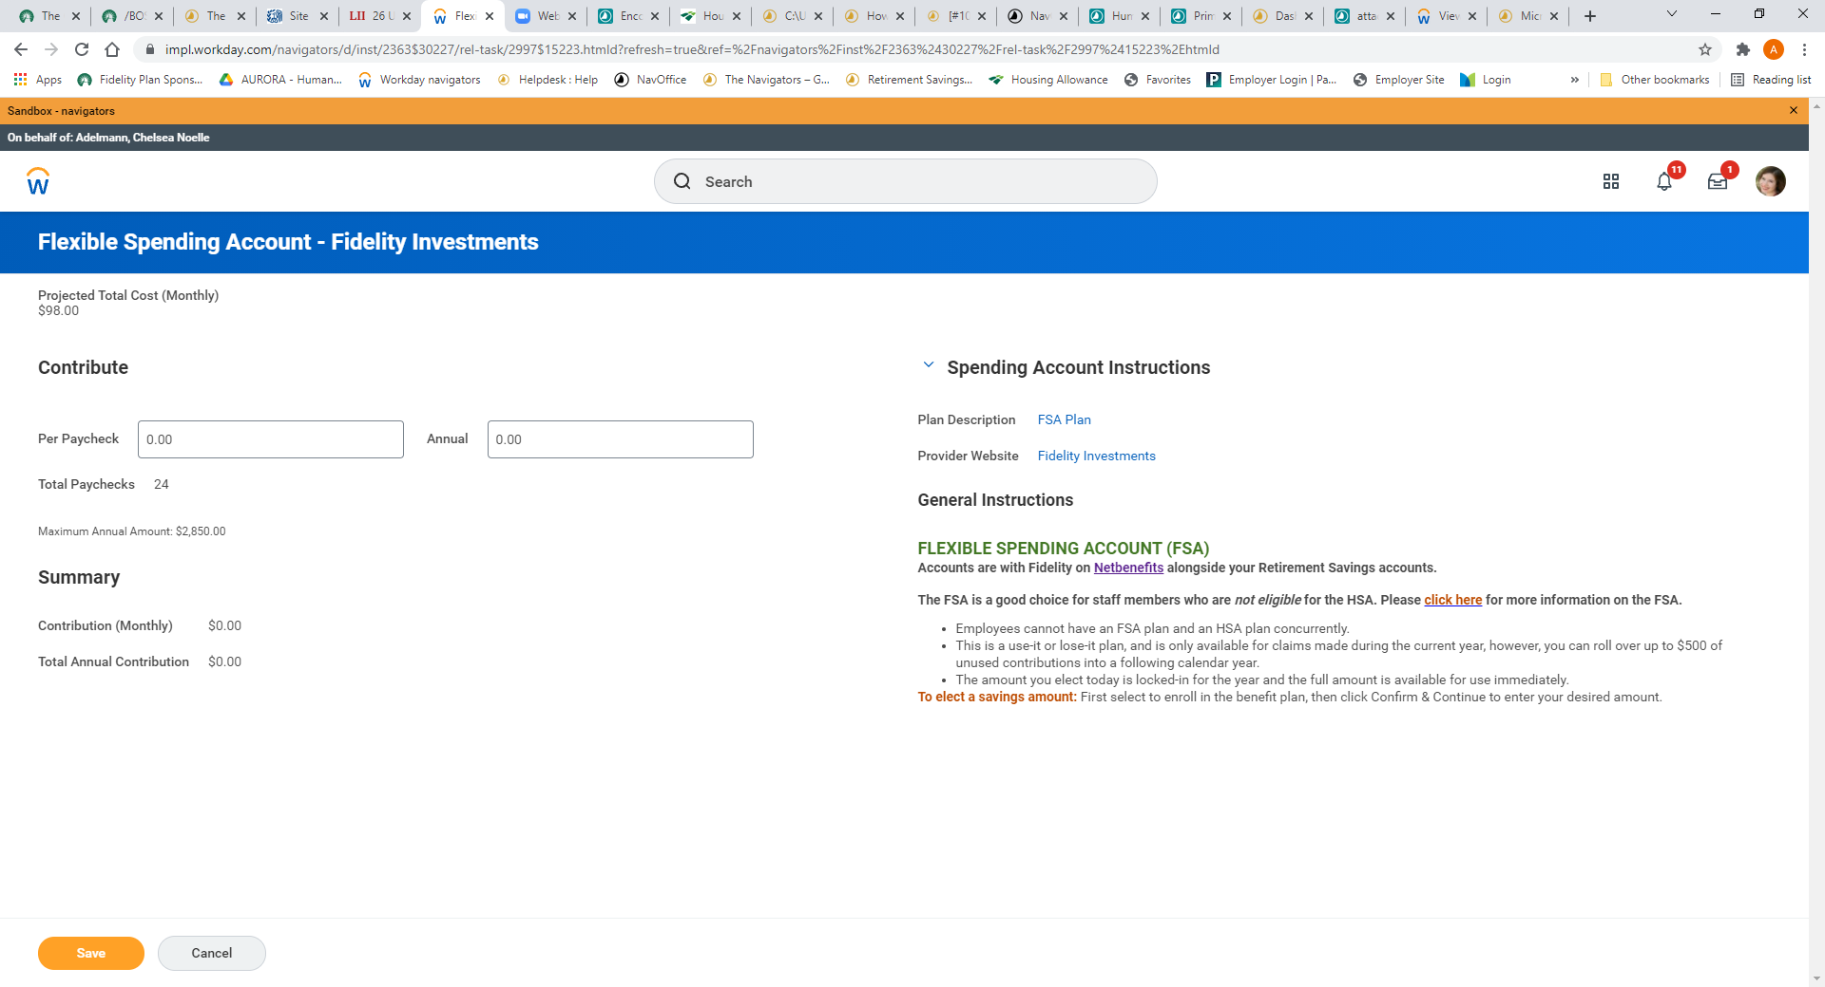
Electing FSA Contributions
The FSA is a good choice for staff members who are not eligible for the HSA
Select an annual amount to be divided into 24 deductions or an amount per paycheck (2 deductions a month).
The 2024 IRS maximum contribution amount based on your Medical election is $3,200. Reaching this amount is based on 24 deductions.
Carry over amount is $610.

Slide 9
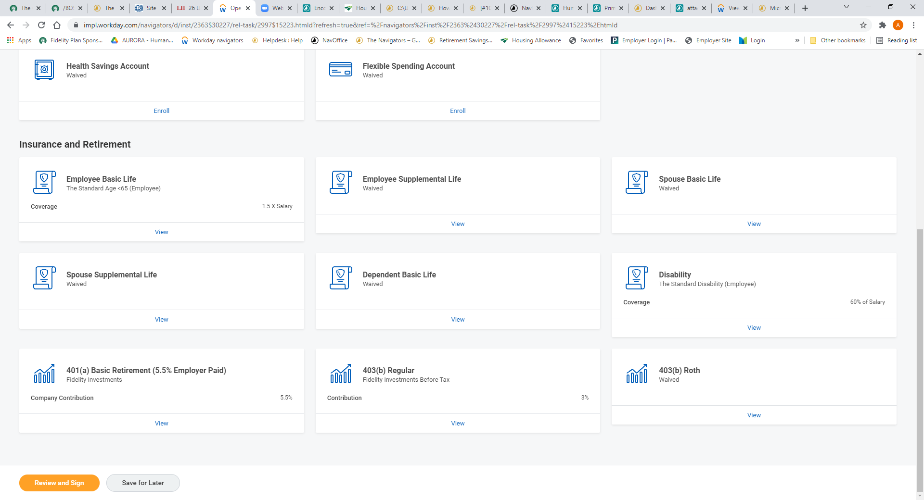
Review Insurance and Retirement Benefits
All Benefit Eligible Navigators and their families are covered by a "Basic" term-life policy. For additional coverage, you can enroll in Supplemental Life Insurance coverage.
Please see the Supplemental Life/Spouse Basic Life/Dependent Basic Life icons on your benefits page if you wish to enroll.
You may choose to enroll in additional life insurance coverage (term-life). Coverage is subject to approval upon completion of Evidence Of Insurability.
403B Retirement Plan options to help you save for a secure financial future. Employees can enroll anytime at www.netbenefits.com. Automatic enrollment* begins after 2 years of employment

Slide 10
Review Your Elections
Please review the Important information to understand the enrollment process. Open Enrollment closes November 19th, 2023.
Review your elections. If no changes were made the Coverage Begin Date will reflect the initial date of your elections/coverage.
Your monthly deductions are located here. Employee Cost comes from your salary/pay.
All employees must click Submit to complete your 2024 Benefits Elections.
Remember: If you do not submit your elections, your Open Enrollment is not complete

Slide 11
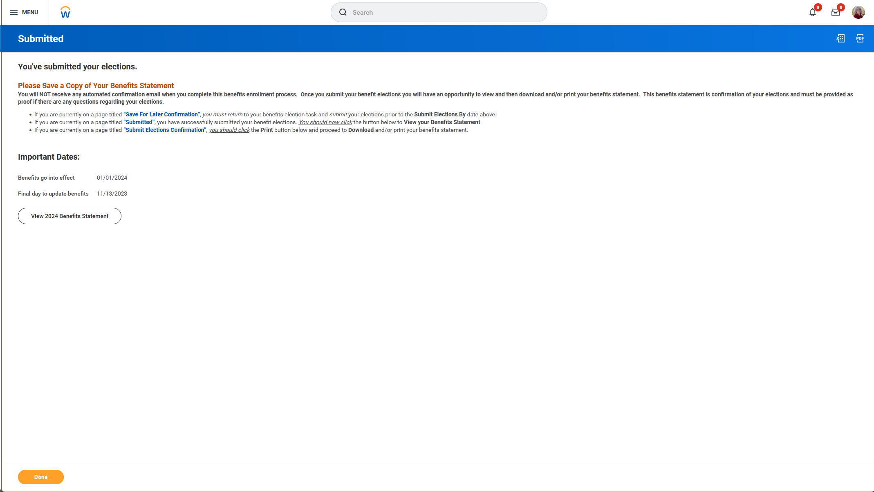
Congratulations!!! You have completed your Open Enrollment!
Please note: If you have waived medical, please continue to next slide

Slide 12
Field Staff Waiver
Field Staff that have waived Medical Coverage will need to upload a Waiver Form into Workday
After Open Enrollment is complete, a new task will be in your Workday Inbox.
Please download the document, fill it out and sign, then drop the file into the task.
Emailing waivers to Benefits is no longer necessary.

Slide 13
Thank you for electing your benefits Access detailed information 24/7 at www.navbenefits.org We look forward to serving you!

